Slide 1
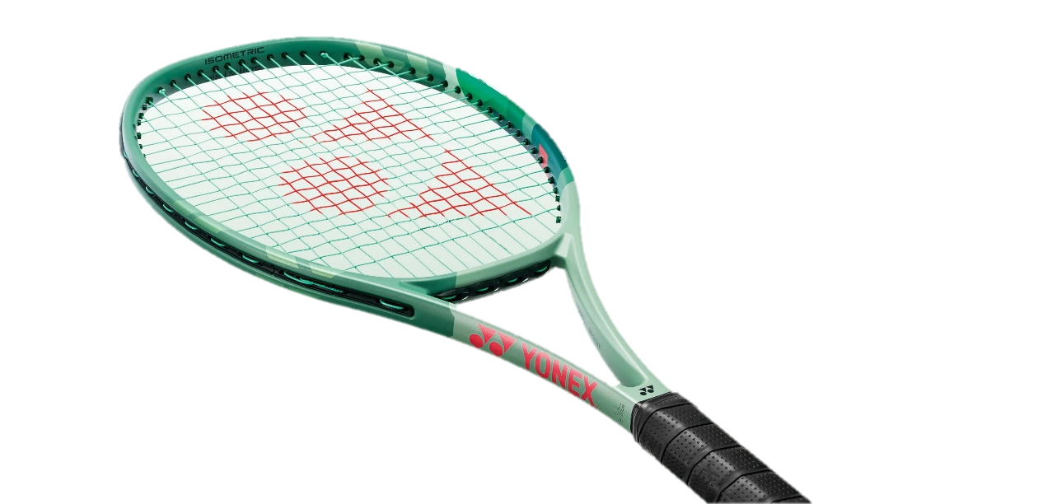
PERCEPT
Percieve, Control, Create

Slide 2
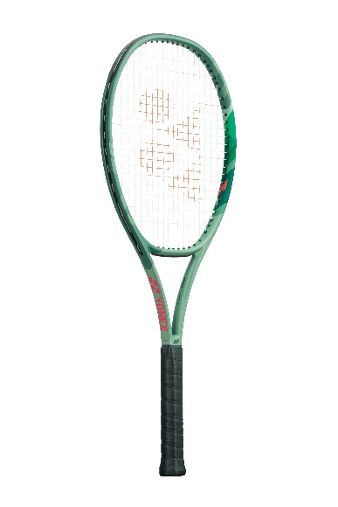
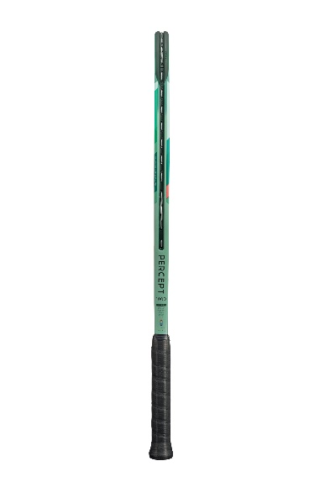
PERCEPT
Percieve, Control, Create
100 D

Slide 3
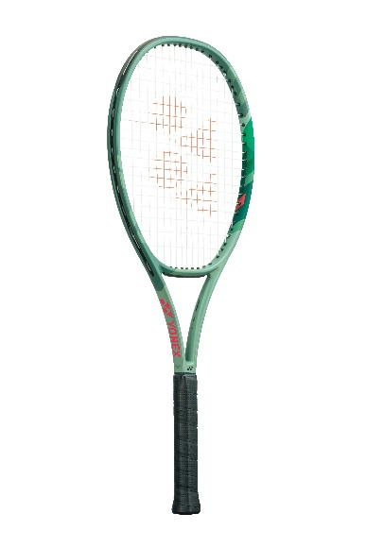
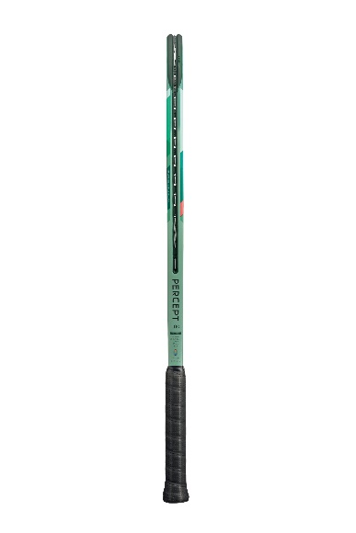
PERCEPT
Percieve, Control, Create
100

Slide 4
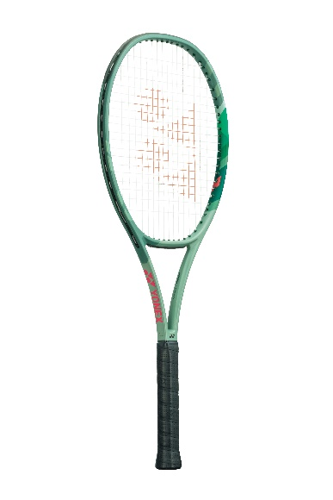
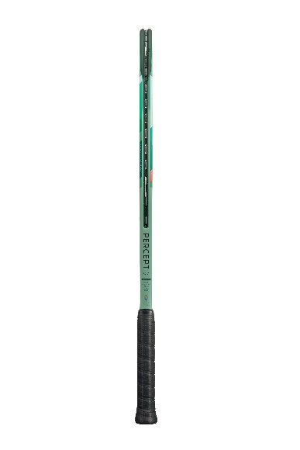
PERCEPT
Percieve, Control, Create
97

Slide 5
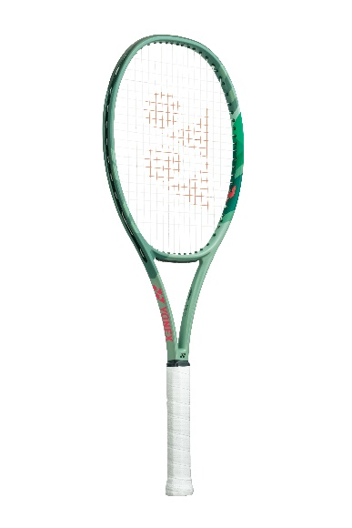
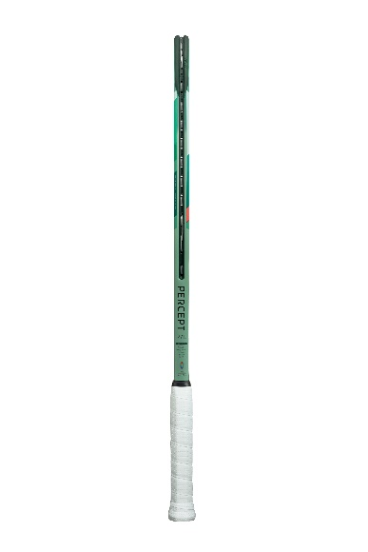
PERCEPT
Percieve, Control, Create
97 L

Slide 6
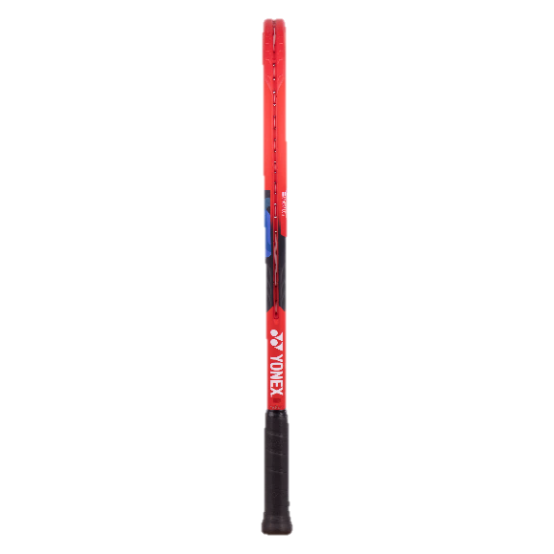
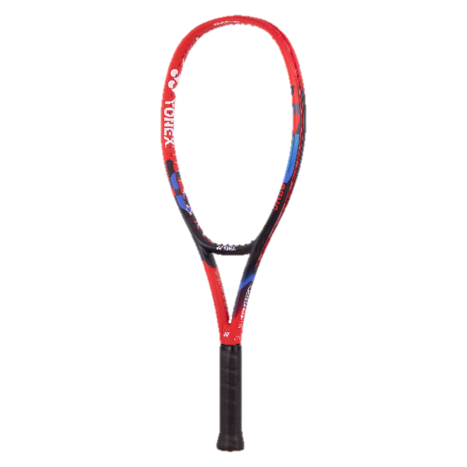
07Vcore
THE ART OF SPIN
Ace
260 gr

Slide 7
97

Slide 8
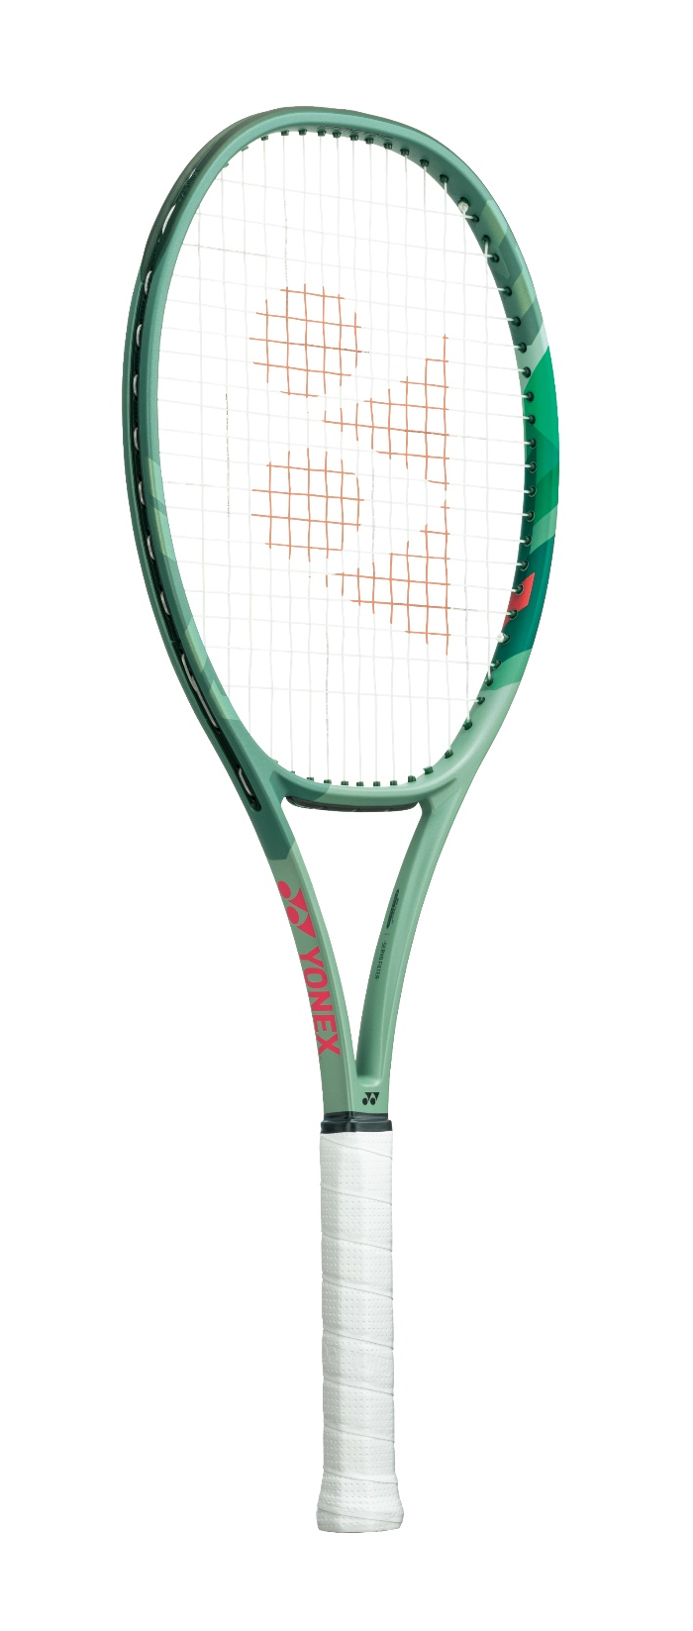
97L

Slide 9
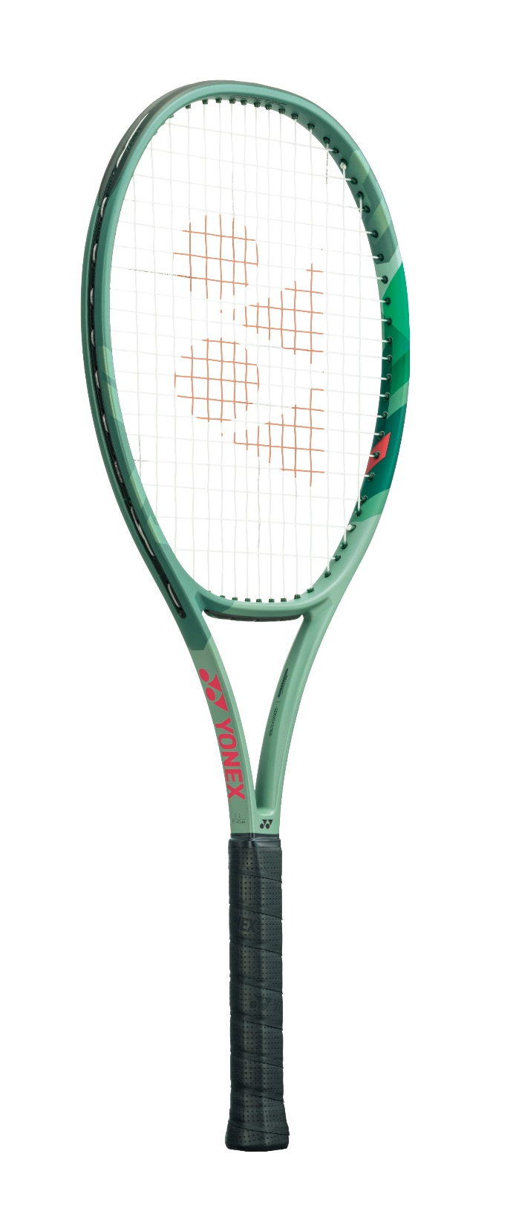
100

Slide 10
100D

